Slide 1
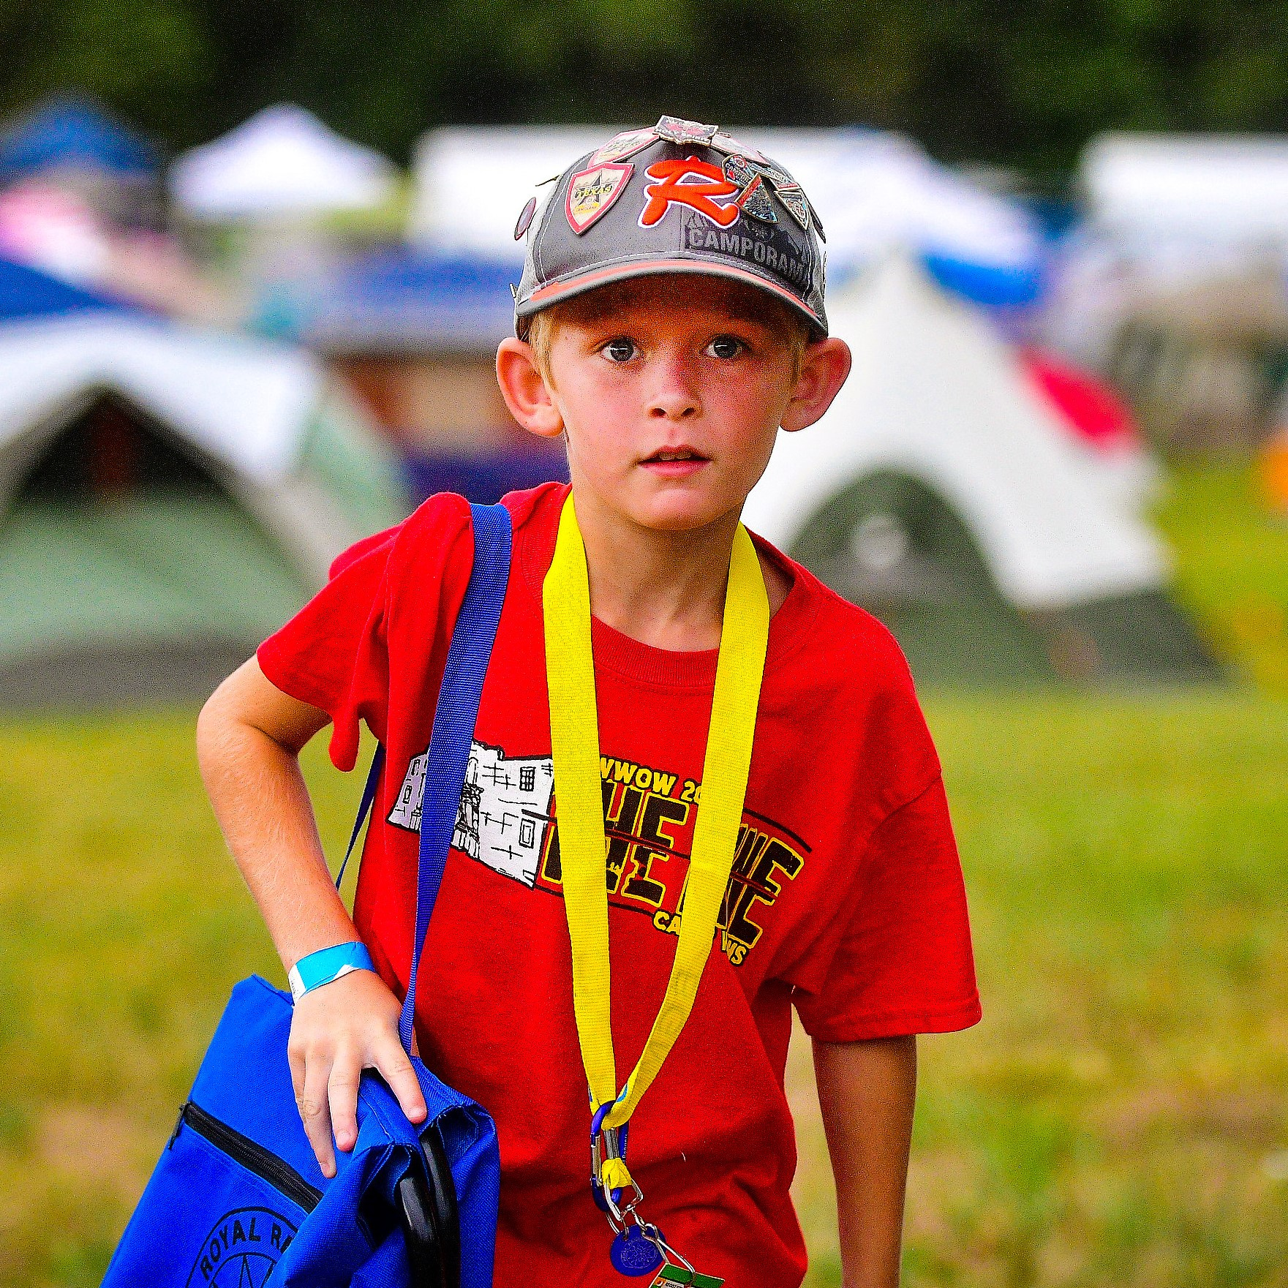
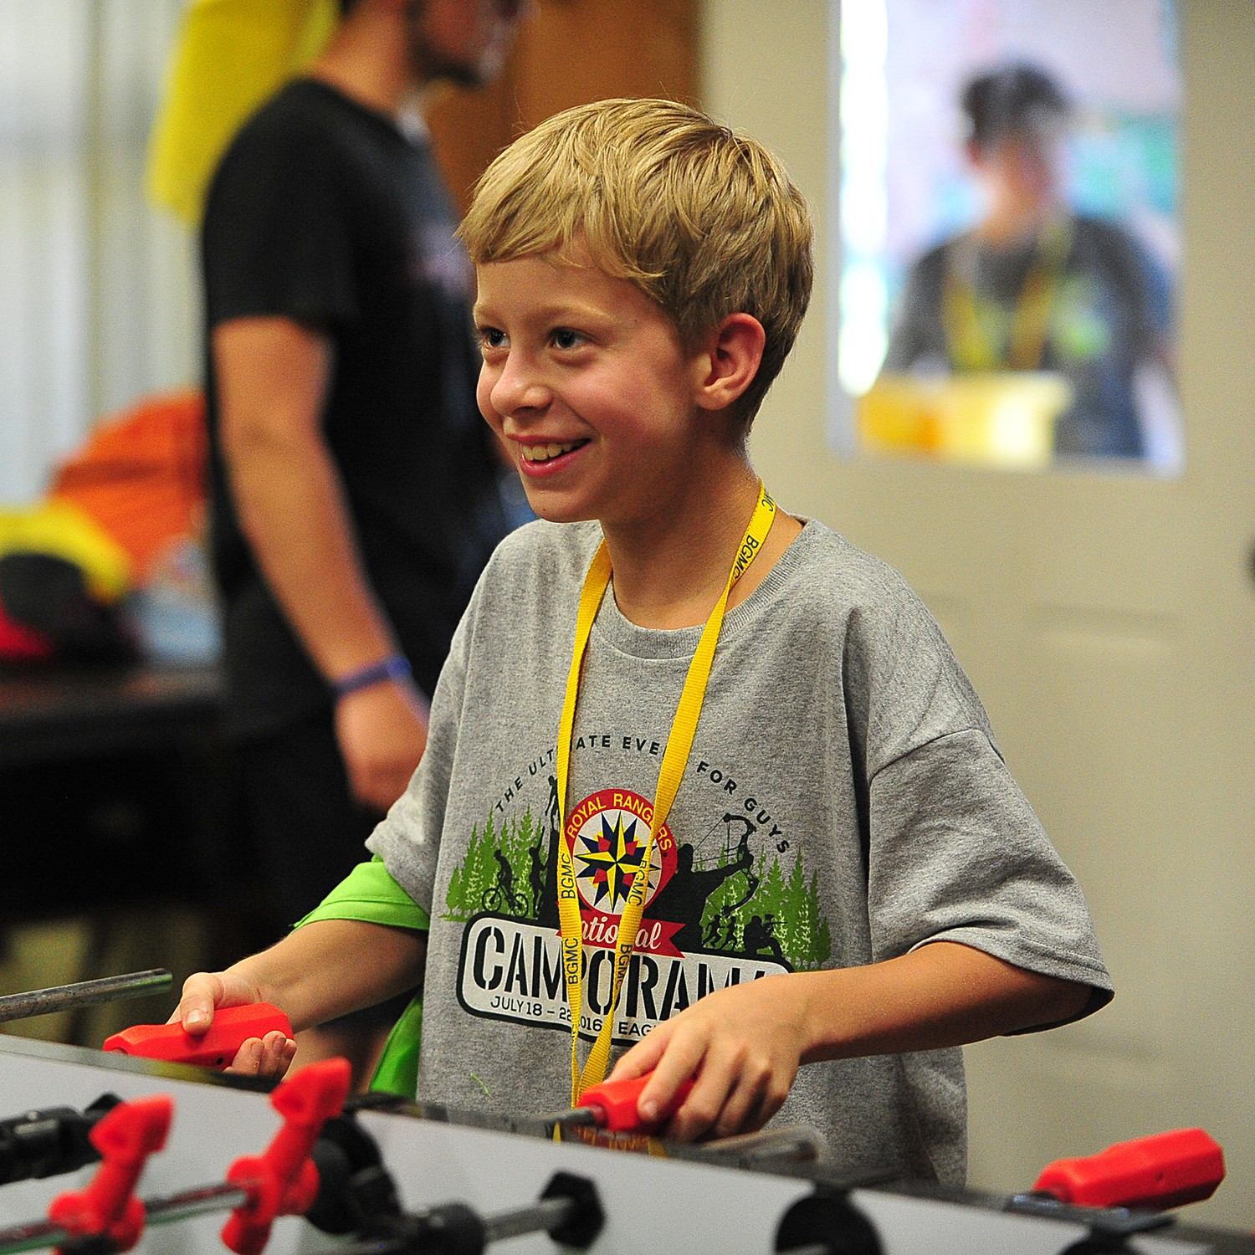
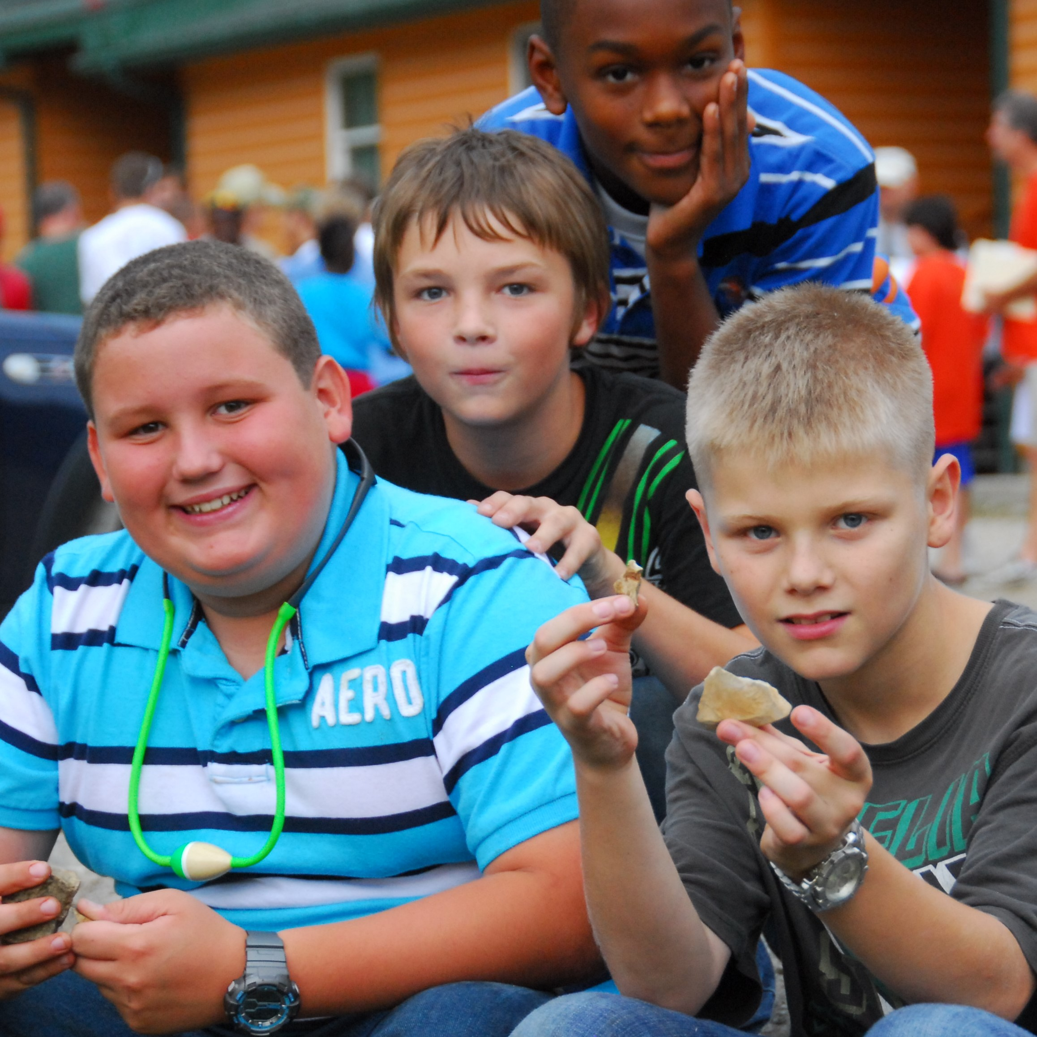
EVERY BOY
INITIATIVE
Reaching Every Boy, in Every Church, in Every Community
Notes:
Introducing the EVERY BOY INITATIVE

Slide 2
1
This generation has incredible potential!
What if that potential is not realized? What if this generation of young men move into manhood not having the opportunity to meet their creator, to realize the hope and plans that are uniquely theirs, or to have an example or a mentor to help them navigate the terrain of adolescence? Statistically, we are told that most of them will not unless we step up!

Slide 3
2
We believe every boy in the United States has the right to know Jesus and to develop into the man God has created him to be. In keeping with the stated vision of “influencing more boys than ever, more effectively than ever,” the Royal Rangers Ministries/Boys Ministries department has launched the EveryBoy Initiative to accomplish this.

Slide 4
3
This initiative focuses on ensuring that every boy in the United States has the opportunity:
To hear the gospel
To discover the man he was created to be
To build the confidence needed to succeed and face life well
To develop strong, lifelong friendships through a community of men

Slide 5
4
Over the last sixty years, more than three million boys in the United States have been mentored through the ministry of Royal Rangers. These boys have grown up to be husbands, fathers, board members, pastors, congressmen, members of the military, airline pilots, businessmen and many other roles. We have the resources, the curriculum, and an army of men who already are discipling boys and young men across our nation. We need you to join us in this quest so we can reach more.

Slide 6
5
Through the cooperative effort of Royal Rangers/Boys Ministries and U.S. Missions, your monthly gift can help supply every evangelical church with the free tools needed to accomplish this task. We have been prepared over the last six decades to make a measurable mark against the flow of our culture that wants to sweep our young men into the night.

Slide 7
6
This initiative will ensure every evangelical church in the United States has free access to either option:
Curriculum and materials developed over many years that can assist churches and leaders in reaching and discipling boys in whatever their cultural setting or church size
An established and developed process of discipling through mentoring using the updated and customizable ministry of Royal Rangers.
Additionally, regardless of the option a church uses to reach boys, they will have access to a nation-wide community of men and boys for support and fellowship.

Slide 8
7
The need is obvious all around us, and the resources are available. Your gift will help bring these two together. As a result of your partnership, every evangelical church will have the opportunity to access these options free of charge to ensure they have the tools to reach as many boys as possible as effectively as possible. Our goal is to be fully funded by the fall of 2023.

Slide 9
Never has the need to step up for the boys of our nation been greater. You can help make a difference.
PRAY. It’s been said, “When we work, we work, but when we pray, God works!” We ask that you pray for the following needs:
God’s protection on the hearts, minds, and lives of the boys of our nation.
The hearts of leaders and men to be open to the plight and needs of our boys.
The Holy Spirit to lead boys and young men to churches and groups that will disciple and mentor them to realize who they are in Christ.
8

Slide 10
9
PARTNER. Join us today by signing up at the link below. Your ongoing monthly support of $25 or more will enable these tools and resources to continue being available to churches. Since these funds will support the growth of ministry and evangelism throughout the United States, this initiative has been approved as a specialized ministry of AG U.S. Missions, and all contributions will receive missions giving credit and are tax deductible.

Slide 11
10
PROMOTE. Help us spread the word. Talk about the mission to reach every boy so the funds of this initiative may be maximized toward resourcing churches and reaching as many boys as possible. We need individuals like you to help us make the need and opportunity known. Share with pastors, the board of your church, businesspeople, the senior adult ministry, men’s and women’s ministry of your church, your friends, and anyone who will listen, the need of boys and the opportunity to help make a difference in their lives.

Slide 12
11
Join us today by signing up at the link below. Your support of this ministry effort will enable us to resource every church, in every community, and take the message of the gospel to every boy in the United States!
If we change a boy, we change a man. If we change a man, we can change a family, a church, and community, and a nation!

Slide 13
EVERY BOY
INITIATIVE
Reaching Every Boy, in Every Church, in Every Community

